Slide 1

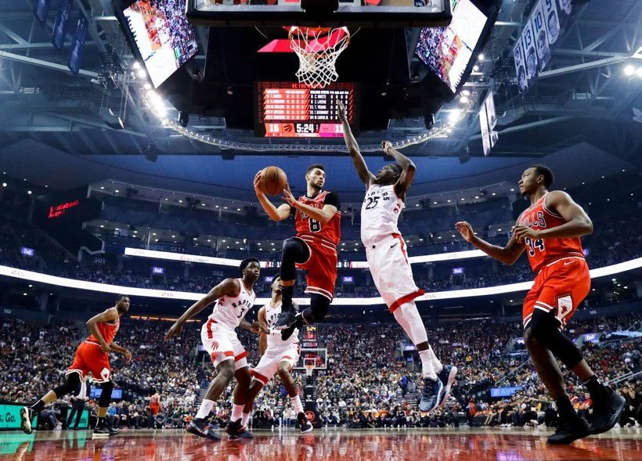

NON-TEXTUAL DATA EXTRACTION
Dakota Mellish Javier Arteaga Rodrigo Castañon

Slide 2

INTRODUCTION
Application of CBIR in basket jerseys
Identify and compare images based on color histograms and similarity measurement between them

Slide 3

PREPROCESSING
Remove Background: Reducing noise, irrelevant, negatively affecting image similarity comparisons
Reshape of Images: Ensures all images have the same dimensions, ensuring compatibility with the network’s input layer

Slide 4

CBIR WITH BGR HISTOGRAMS AND CHI-SQUARE DISTANCE
Region Division: The image is divided into sub-images, and a histogram is calculated for each one.
Similarity Comparison: The Chi- Square distance is used to compare the histograms and find similar t-shirts.

Slide 5
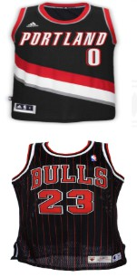
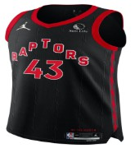
COLOR SEGMENTATION

Slide 6
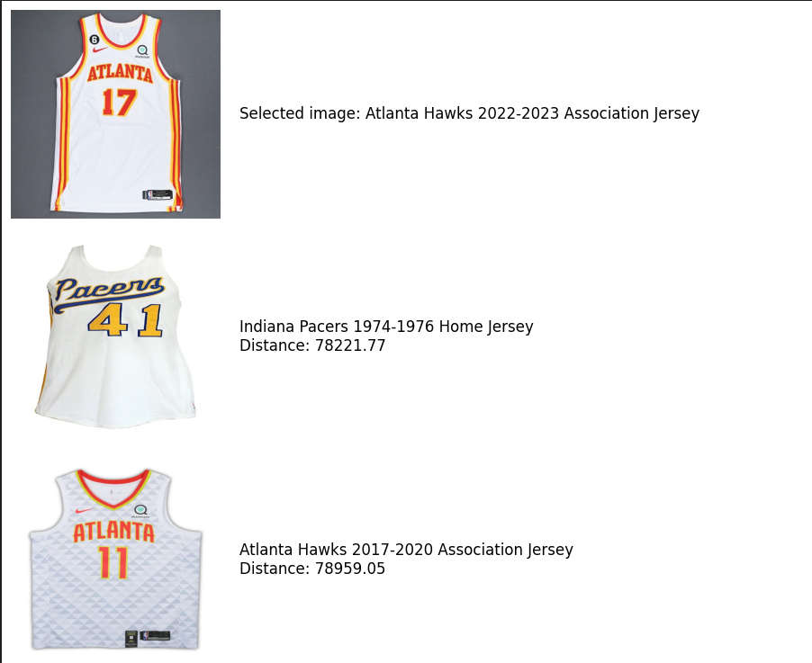
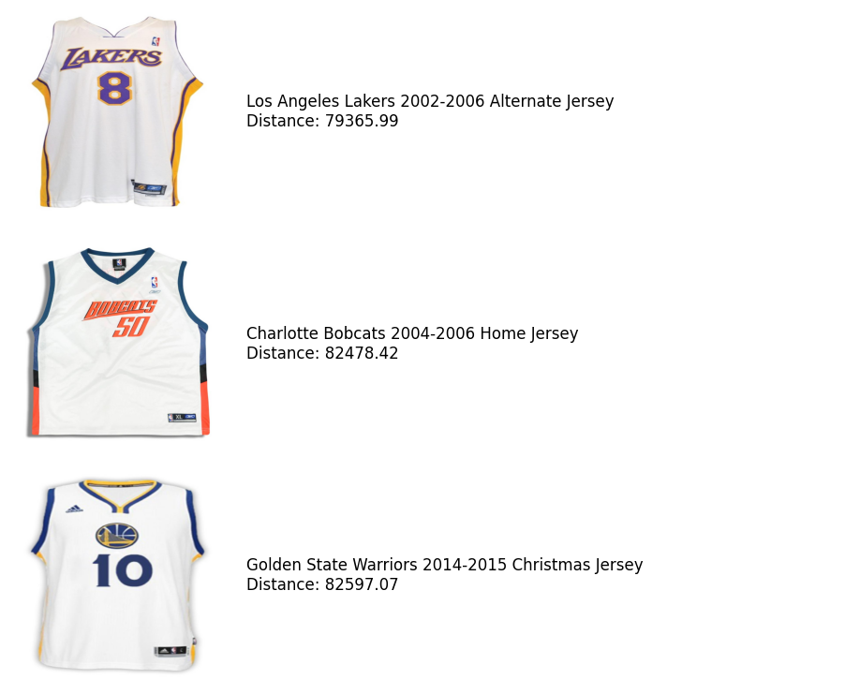
EXAMPLE

Slide 7


DISTANCE USED
n
(x_{i} - y_{i}) ²
x_{i} - y_{i}
d(x,y) =
i=1

Slide 8

HISTOGRAM OF ORIENTED GRADIENTS (HOG)
Grayscale Conversion
Gradient Extraction
Cell Division
Block Normalization
Gradient Extraction
HOG visualization

Slide 9
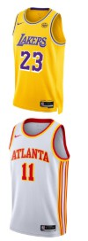



TESSERACT OPTICAL CHARACTER RECOGNITION

Slide 10
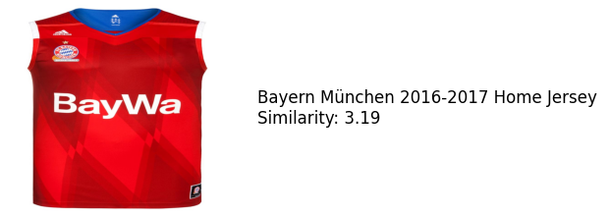
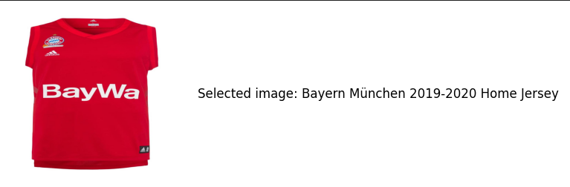
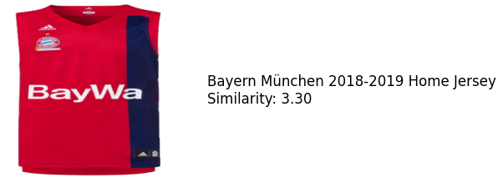
EXAMPLE

Slide 11
COMBINATION
Normalize distances
Ordered distances
Query best jerseys based on color or OCR
Refine using the unused descriptor

Slide 12
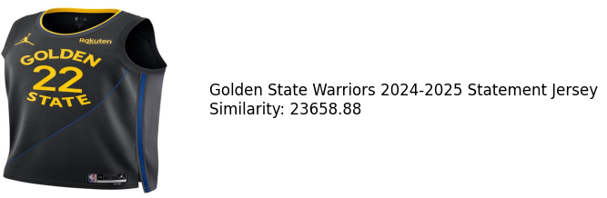
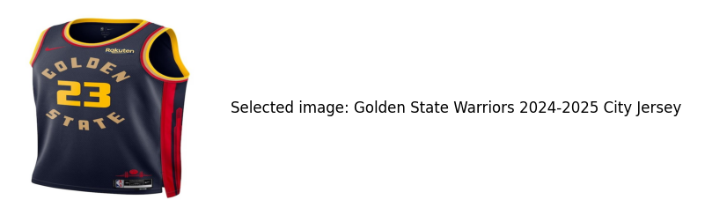
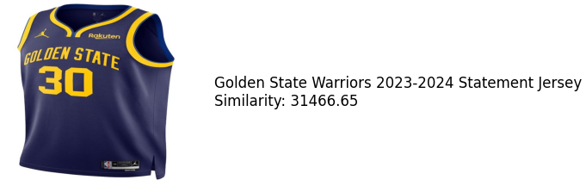
EXAMPLE

Slide 13


IMPROVEMENT PROPOSALS
Improve Color Discrimination
Histogram Normalization EasyOCR vs Tesseract OCR CNNs (ResNet, VGG)

Slide 14

THANK YOU!

